Slide 1
Marketing Requirements

Slide 2
The Name of the Product
The software product we are going to develop is an Android app named Hobby Tracker.

Slide 3
The Target Customers
The target customers are those who have some hobbies and who try to track hobbies in their daily life just using cellphones.
For example, to practice the chords of guitar, a set shot of basketball, or to solve life and death problems of Go, etc.

Slide 4
Potential Competitive Products
Products are in competition with Hobby Tracker: Apps used in cellphone, such as WeChat Sports, which is made by Tencent, the biggest IT company in China.

Slide 5
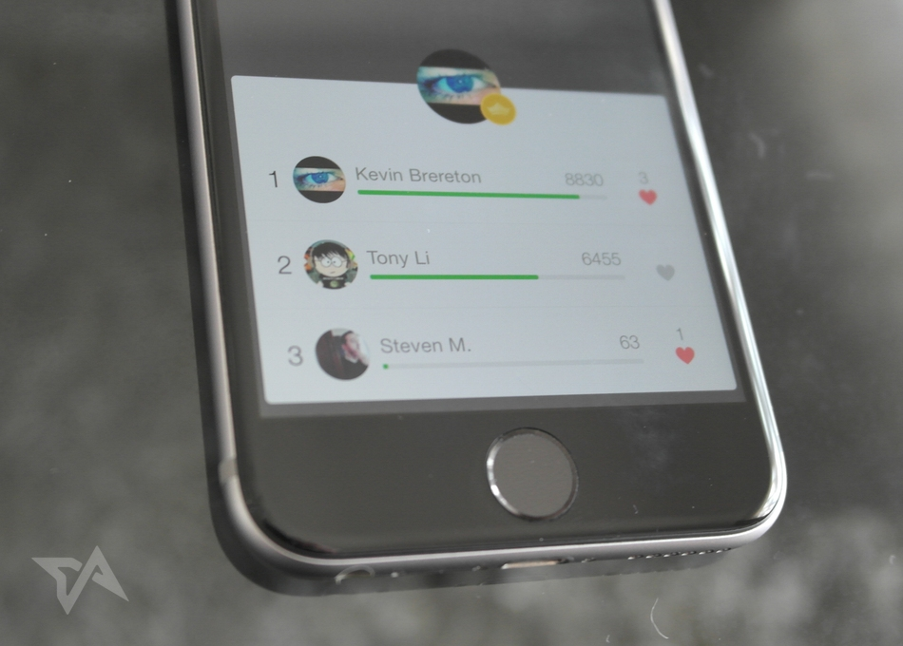

Slide 6
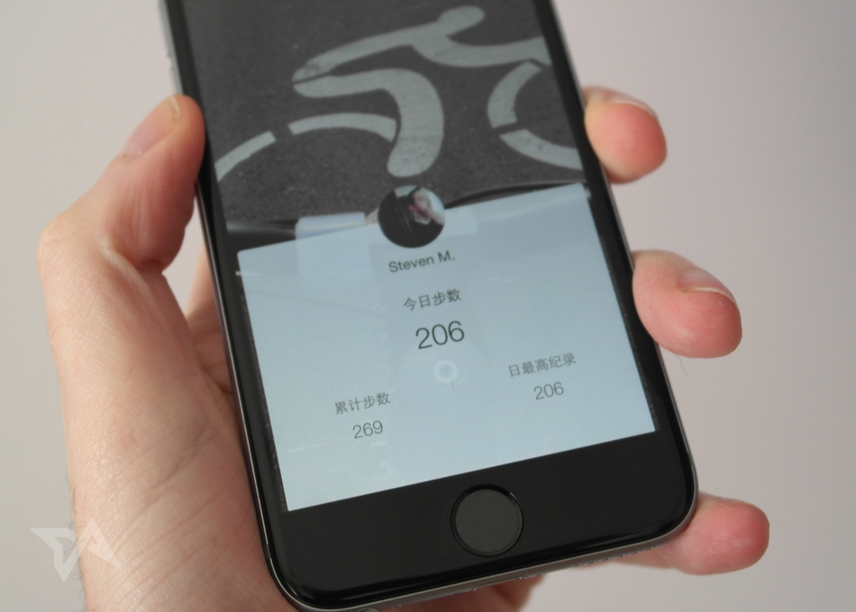

Slide 7
Hobby Tracker only counts what you have finished each day , and shows a cumulative total, so it doesn’t reveal more sensitive info like your locations or specific times that you’re moving.

Slide 8
Customers are likely to use Hobby Tracker
1 – Your profile shows your daily achievement as well as a cumulative total
2 – All you done can be turned into a social competition, complete with a daily leaderboard that covers all your friends who have also opted in.
3 – You can even build a great community for your own.

